Slide 1

PRODUCT CATEGORY CREATION FOR HEALTHCARE KIOSKS IN INDIA
Team Name : Duo Tech
Team Members:
Aishwarya. K V
Thanushree. B S

Slide 2
PROJECT VISION & OBJECTIVES
Vision:To design an AI-powered Healthcare Kiosk that delivers smart, secure, and accessible healthcare services across India particularly targeting rural and semi-urban areas.
The solution integrates advanced technologies such as face recognition, automated vitals monitoring, secure user authentication, and medication dispensing, enabling end-to-end digital healthcare support.
Project Objectives:
Contactless Patient Identification Implement face recognition to streamline patient check-in and improve both security and speed.
Automated Vitals Monitoring Capture essential vitals like heart rate, body temperature, and oxygen levels without manual intervention.
Medication Dispensation Deliver prescribed medicines through kiosk-integrated hardware modules automatically.
Secure Access via Authentication Ensure that only authorized users access the system using password-based login mechanisms.
User-Friendly & Scalable Deployment Design the kiosk to be intuitive, affordable, and easy to install in rural clinics and healthcare centers.

Slide 3
THE PROBLEM AND NEED
The Problem:
India’s healthcare system, especially in rural and semi-urban regions, is facing serious challenges such as:
Shortage of medical staff Doctor-patient ratio is far below WHO guidelines, leading to long wait times and limited access to care.
Manual and time-consuming processes Patient registration, vital checks, and medicine dispensation are mostly manual, causing inefficiencies.
Lack of digital infrastructure Most clinics still use paper records or disconnected digital systems, making it hard to manage patient data securely and efficiently.
Inequality in healthcare access Rural areas lack diagnostic facilities, expert doctors, and modern tools — leading to delays in treatment and poor health outcomes.

Slide 4
The Need
There is a strong need for a smart, tech-enabled, and affordable healthcare solution that can:
Digitize patient registration, vitals check, and medication dispensation.
Provide secure access to patient data and reports.
Work autonomously with minimal human supervision.
Be easily deployed in rural, remote, and underserved regions.
Align with government initiatives like Ayushman Bharat Digital Mission (ABDM) and Digital India.

Slide 5
PROPOSED SOLUTION
To address the inefficiencies and accessibility challenges in the healthcare system, this project proposes a software-based Healthcare Kiosk simulation. The system demonstrates how AI and automation can improve patient interaction, monitoring, and preliminary diagnosis without manual intervention.
Solution Highlights
Face Recognition for contactless patient identification.
Passkey Authentication to ensure secure access control.
Vitals Monitoring Module to track heart rate, temperature, and blood pressure.
Health Status Evaluation to detect abnormal conditions such as high blood pressure.
Medication Suggestion & Dispensing Simulation based on health analysis.
Implementation Scope
The solution is developed entirely in software using Python and key libraries such as:
face_recognition, dlib, opencv-python for face detection.
Simulated input and logic-based conditions for health analysis and output.
Designed to run within a terminal interface in real-time.

Slide 6
FEATURES
1.Face Recognition Module
Utilizes face_recognition and dlib libraries.
Captures webcam input, detects and encodes faces.
Matches with stored face data to authenticate the user.
2. Passkey Authentication
Adds an extra layer of security after face recognition.
User must enter a predefined numeric password.
Access is granted only on successful verification.
.

Slide 7
3. Vitals Monitoring Module
Simulates the capture of essential health parameters:
Heart rate
RateBody
Temperature
Blood Pressure
4. Health Status Evaluation
Analyzes vitals to detect abnormal conditions (e.g., high BP).
lags alerts to simulate real-time diagnosis logic.
5. Medication Suggestion & Dispensing Logic
Based on the diagnosed condition, the system recommends appropriate medicine.
Simulates medicine dispensing via terminal output.

Slide 8
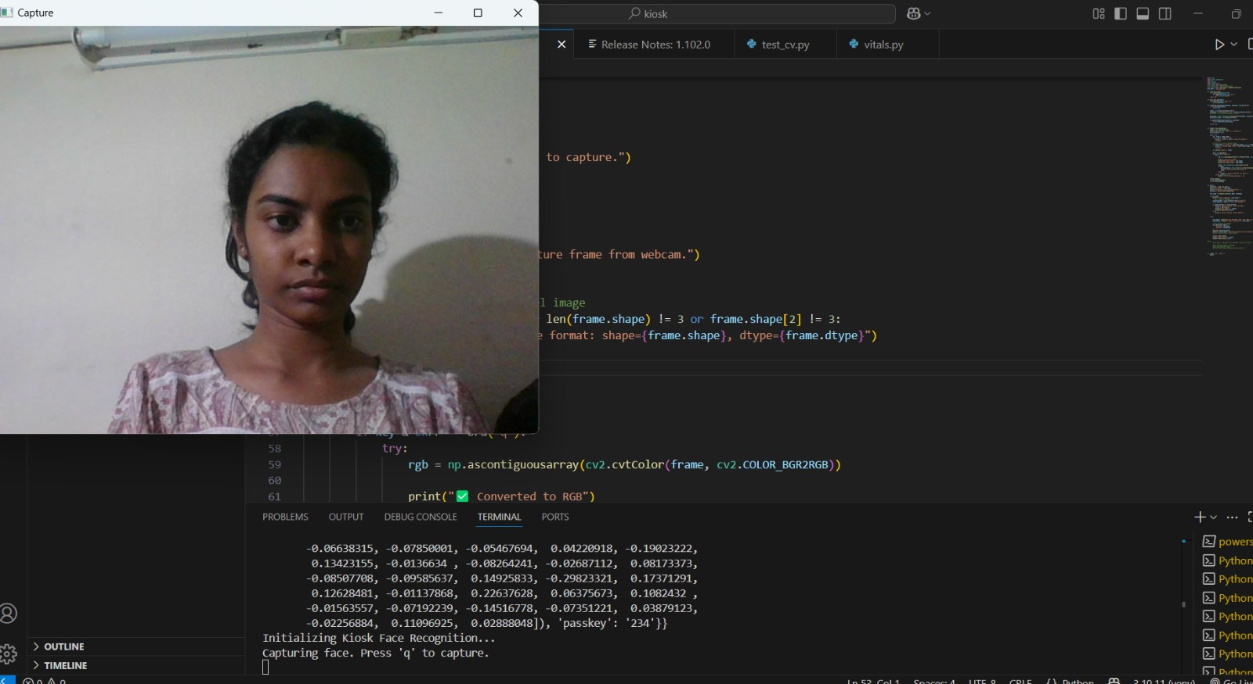
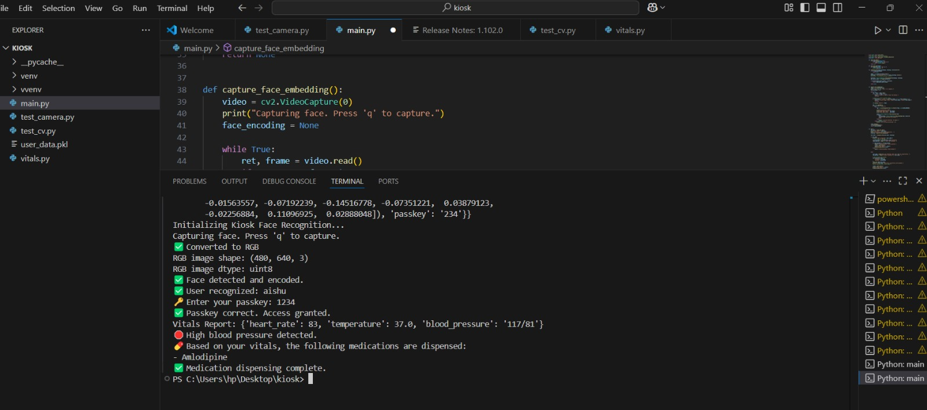
SOFTWARE EXECUTION – FACE RECOGNITION AND HEALTH ASSESSMENT

Slide 9
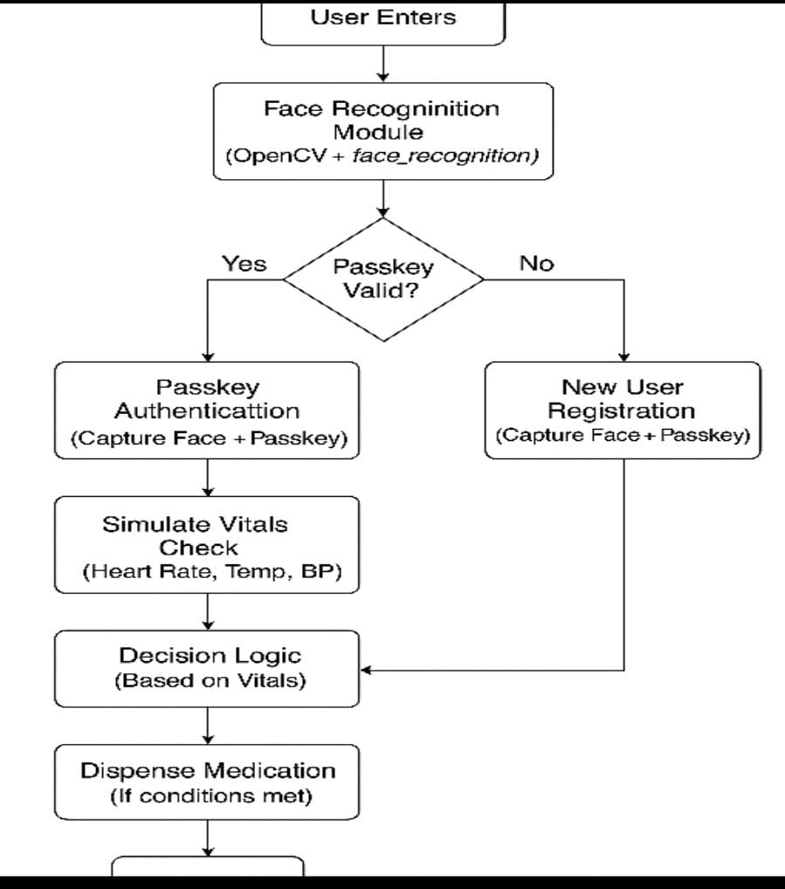
SYSTEM ARCHITECTURE

Slide 10
CHALLENGES FACED
Integration of Multiple Technologies
Bringing together various modules such as face recognition, vitals monitoring, medication dispensing, and password authentication into one cohesive system required careful architectural planning and technical alignment.
Face Recognition Implementation
Developing real-time facial recognition using dlib and face_recognition presented challenges related to lighting conditions, user angles, and camera precision. Ensuring consistent and accurate identification was critical.
Environment and Dependency
SetupSetting up the Python environment with required dependencies (OpenCV, cmake, etc.) resulted in version mismatches and compatibility issues. Multiple installations and configurations were needed to stabilize the development environment.
Secure Authentication Design
Designing a secure yet user-friendly authentication flow required integrating password-based login alongside face recognition. Ensuring data privacy and access control within a public kiosk setting was a key focus.

Slide 11
FUTURE ENHANCEMENTS
Voice-enabled Interaction System
Implementing voice-based assistance in regional Indian languages to improve accessibility for elderly and non-literate users.
Text-Based Question Answering Module
Adding an AI-powered module to allow users to type health-related queries and receive intelligent responses from the kiosk.
Integration with India Stack & Ayushman Bharat Health ID
Linking the kiosk to national digital health infrastructure to fetch and update patient records securely and in real-time.
Multilingual Interface Support
Enabling users to interact with the kiosk in multiple Indian languages, enhancing inclusivity and reach.
Real-Time Cloud Data Sync & Teleconsultation
Uploading vitals and patient information to a secure cloud system for remote access by doctors and telemedicine platforms.
E-prescription and Diagnostic Integration Extending support for doctors to send e-prescriptions directly to the kiosk and receive vitals + history for better diagnosis.

Slide 12
CONCLUSION
This project demonstrates the feasibility and impact of building a smart, affordable, and user-friendly AI-powered Healthcare Kiosk tailored for the Indian healthcare ecosystem.
Core functionalities such as face recognition, vitals monitoring, password-based access, and medication dispensing were successfully developed and integrated.
The kiosk addresses key healthcare challenges such as doctor shortages, manual processes, and limited access in rural areas, while aligning with national initiatives like the Ayushman Bharat Digital Mission.
The proposed roadmap includes advanced features such as voice interaction, teleconsultation, multilingual support, and cloud integration, paving the way for scalable deployment and real-world use.
Through this internship, we gained valuable hands-on experience in AI integration, system design, troubleshooting, and team collaboration.

Slide 13

THANK YOU

